Slide 1
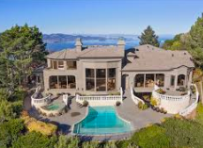
Notes:
So You've found your dream home. The asking price is $600,000 -- an amount you've already been pre-approved for by your bank. But is the home really worth that amount? That's the question at the heart of the home appraisal. The worth, or value of the property, will determine how much a lender is willing to give you to by that particular piece of real estate.

Slide 2

Notes:
Thank you for giving opportunity to introduce myself and my geoup.
Data scientist - I am a product manager at We are a large ‘Appraisal management company’ in the country .
Offer Full suite of valuation services that we offer in different verticals.

Slide 3

Our Vision
Combine technology and experience of our appraisers , to deliver appraisals faster, with higher transparency and credibility to our stakeholders .
Goal -
Pilot project update in Ames Iowa
Leverage data to build a machine learning model for residential properties, to provide estimated price of a home in Ames Iowa
- sales during 2006 to 2010.
- 79 feature 2051 homes and their prices.
Notes:
There is oppotunity to innovate in apprasal space

Slide 4
primary appraisal methods :
sales comparison approach:
compare the property with three or four similar homes that have sold in the area, often called comparables, or comps.
The analysis considers specific components, such as lot size, square footage of finished and unfinished space, style and age of house, as well as other features such as garages and fireplaces.
Cost approach (is used more for new property)
based on reproduction costs.
estimates the cost to replace the structure on the property if it were destroyed.

Slide 5
Process
1
2
3
4
5
6
W1
W2
W3
W4
W1
W2
W3
W4
W1
W2
W3
W4
W1
W2
W3
W4
W1
W2
W3
W4
W1
W2
W3
W4
Cleaning
Exploratory Data Analysis
Feature Engineering
Feature Selection
Build model
Evaluate model
LOREM

Slide 6
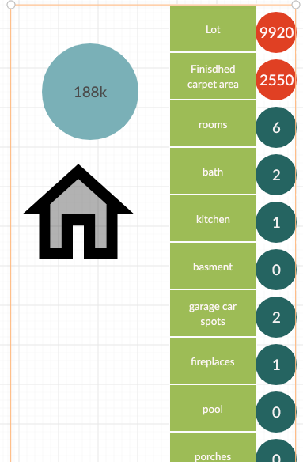

Average Ames home:
2051 x 81
23 neighborhoods
Sale Price- 2006 - 2010
ord_Overall Cond
Notes:
ord_Overall Cond
2045.0
1.0
9.0
5.561369
ord_Overall Qual
2045.0
1.0
10.0
6.112958

Slide 7
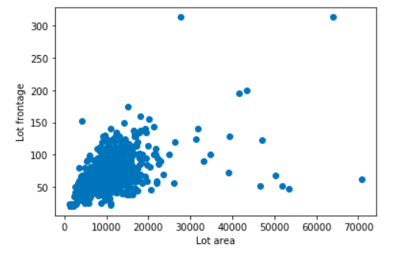
Cleaning
Renamed ordinal columns
Pool and Fireplace , Garage and basement attributes were set to 'NA'
Lot frontage were imputed from homes which are within 5% lot areas
Test data cleaning.
Notes:
https://www.investopedia.com/articles/personal-finance/111115/zillow-estimates-not-accurate-you-think.asp

Slide 8
Exploratory Data Analysis
More than 50 % houses have regular lot size, around 25% are slightly irregular.
99% houses have all utilities, electrical and heating
95% of the houses have gentle slope with a very few house with severe slope
65% have no basement exposure
90% homes have Paved Drive
70% homes are in ‘Residential Low Density’ zone and another 10% make up in ‘RM’
Notes:
Lot Shape - regular
Utilities -All public Utilities (E,G,W,& S)

Slide 9
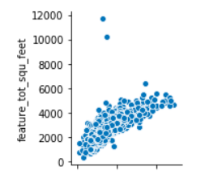
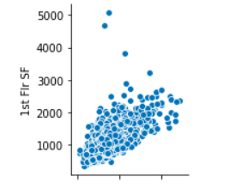
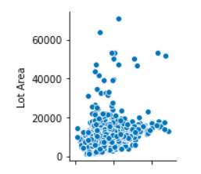
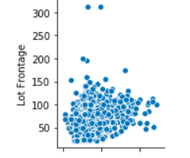
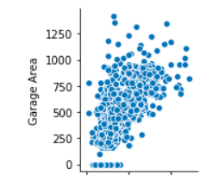
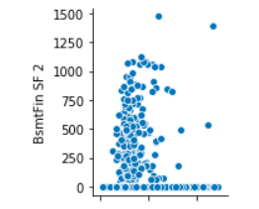
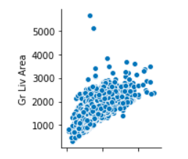
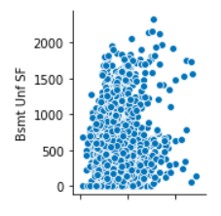
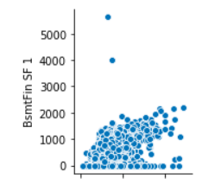
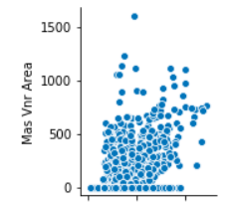
Real Estate !

Slide 10
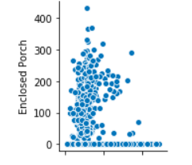
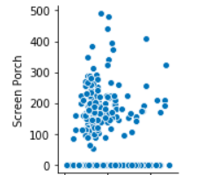
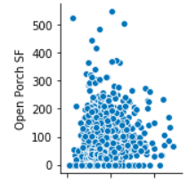
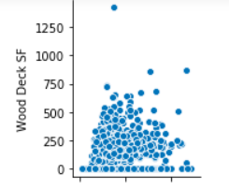
PORCH AND DECK

Slide 11
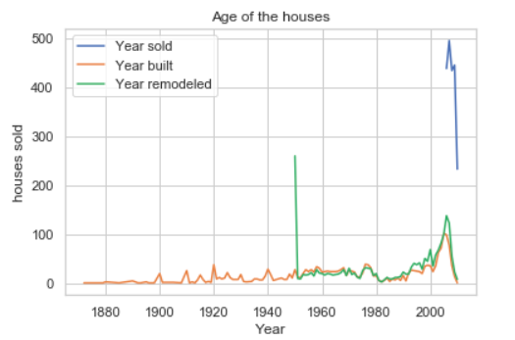
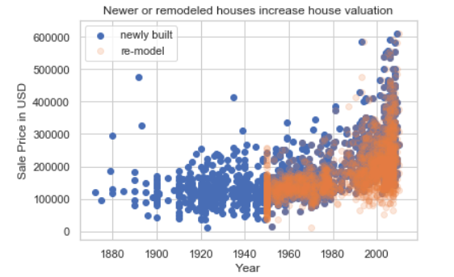
NEW OR REMODELLED HOUSE?

Slide 12
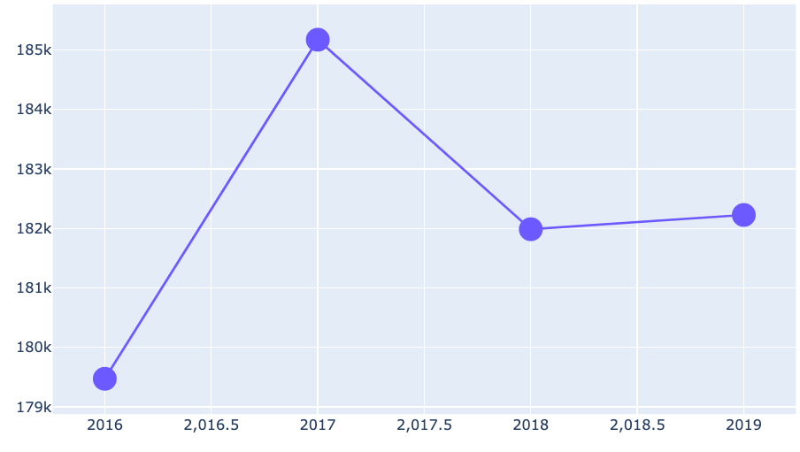
Average sale price year-over year

Slide 13
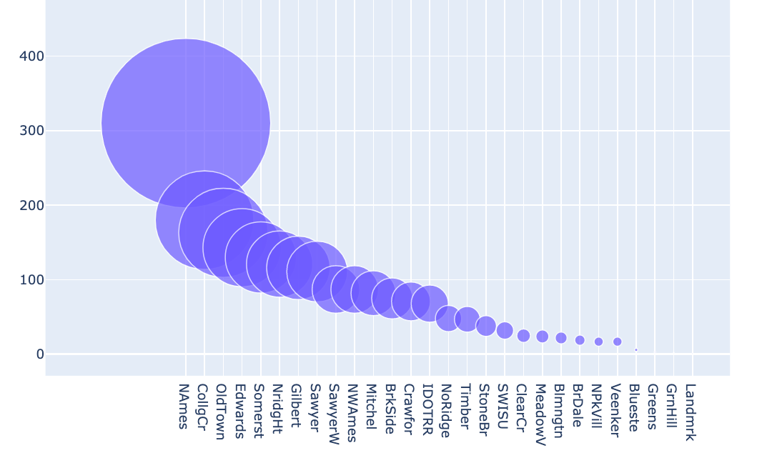
23 neighborhoods and home prices

Slide 14
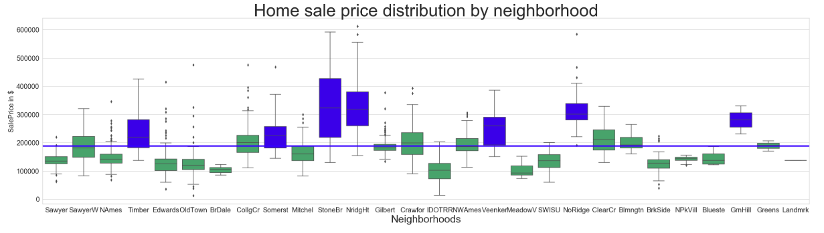
23 neighborhoods and home prices

Slide 15
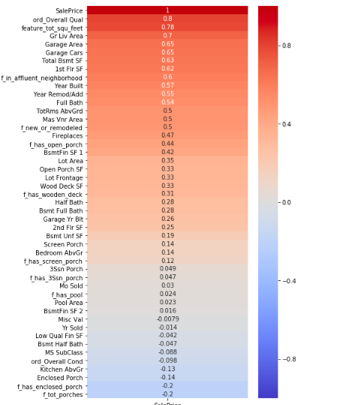
Feature Selection - round 1
Notes:
https://www.investopedia.com/articles/personal-finance/111115/zillow-estimates-not-accurate-you-think.asp

Slide 16
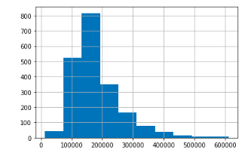
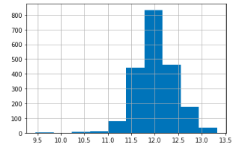
Phase 2 : logarithmic transformation- Sale price -
Notes:
Right skewed to normal distribution
2nd Flr SF'
Bsmt Unf SF
BsmtFin SF 1
BsmtFin SF 2'
Enclosed Porch'
Enclosed Porch
Lot Frontage Mas Vnr Area

Slide 17
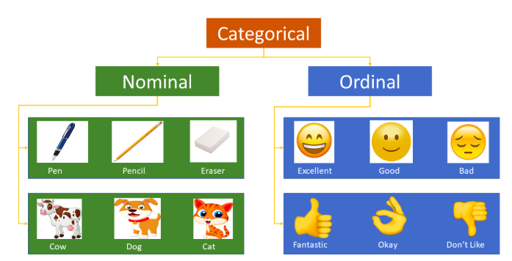
Phase 3 : To Numerical columns
* Ordinal columns translated to ordered numerical columns
* Nominal columns in to dummy variables
Lot Config,Condition 1,Condition 2 ,Sale Type
Notes:
rdinal_Overall Qual ordinal_Overall Cond ordinal_Lot Shape
ordinal_Utilities ordinal_Land Slope ordinal_Exter Qual
ordinal_Exter Cond ordinal_Bsmt Qual ordinal_Bsmt Cond
ordinal_Heating QC ordinal_Kitchen Qual ordinal_Fireplace Qu
ordinal_Garage Qual ordinal_Garage Cond ordinal_Pool QC
ordinal_Bsmt Exposure ordinal_BsmtFin Type 1 ordinal_BsmtFin Type 2 ordinal_Electrical
ordinal_Garage Finish ordinal_Paved Drive ordinal_Fenc

Slide 18
Feature creation
New House or remodeled?
Total number of porches
higer_priced_neighborhoods
Does house has pool ?
Does house has deck ?
Total square feet
Notes:
https://www.investopedia.com/articles/personal-finance/111115/zillow-estimates-not-accurate-you-think.asp

Slide 19
Model building
Multiple Linear Regression model
Train and test data split 75 /25
33 Features ( the limit threshold = 45)
Notes:
https://www.investopedia.com/articles/personal-finance/111115/zillow-estimates-not-accurate-you-think.asp

Slide 20
Model Evaluation
Loss functions -
RMSE 42806 ( Std deviation -79218)
R2 scores
train R2 score =0.8587216537934146,
Cross validation Score= 0.8394628652019798
test score =0.866208676425907

Slide 21
Ms. Kaggle’s Scoring report
Rookie score | 82267
Transform Sale price to be normal distributed | 28658
Numerical columns with very high positive or negative co-relationship | 24885
Ordinal columns very high positive or negative co-relationship | 23962
Adding dummy variables | 23801
Adding new features | 23158
Notes:
https://www.investopedia.com/articles/personal-finance/111115/zillow-estimates-not-accurate-you-think.asp

Slide 22
Conclusions & Upcoming work
Promising initial quantitative results
80% of the time the model is able to explain the variability in data
No model is perfect
Would like team of appraisers to validate how close the results are to what they would appraised value to and incorporate the suggestions in the model along with some of the following that got pushed out from current sprint :
Scaling
Revisiting dummy variables
Trying some of the more advanced linear regression models

Slide 23
References
https://www.canva.com/design/DADxCuEgsis/UlKO4wGPQSaDaXECDmlzZQ/edit
https://corneliuscamp.com/100-catchy-real-estate-advertising-slogans-and-timelines/
http://jse.amstat.org/v19n3/decock/DataDocumentation.txt

